Slide 1

PCA on Hand-Written Digits
By Abhishek Alva,
Nidhi Shivakumar and
Omkar Nanekar

Slide 2
Content
Description
Approach
Parallelization
Modeling
Results
Applications
PCA

Slide 3
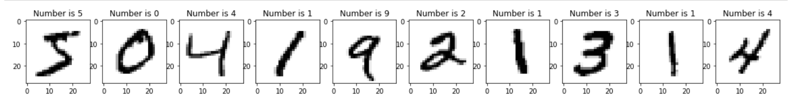
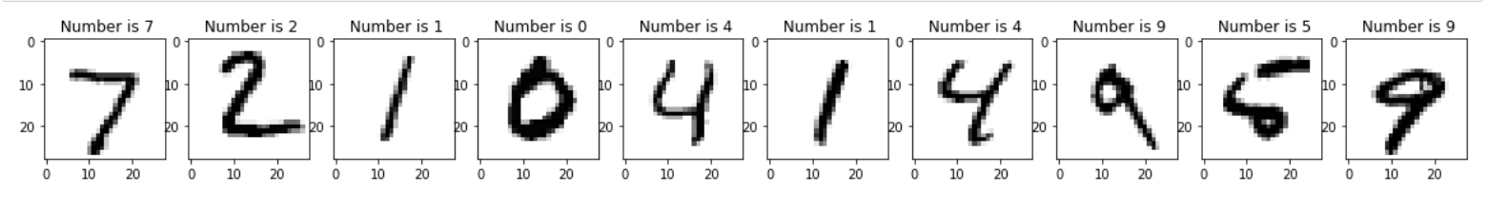
Description
Train data Visualization
Dataset – Train (60,000) and Test (10,000)
Pixels and Dimension
Target Variable
Test data Visualization

Slide 4
Approach
Data cleaning- checking NA values
Converting into binary from gray scale: divide by 255
How PCA works?

Slide 5
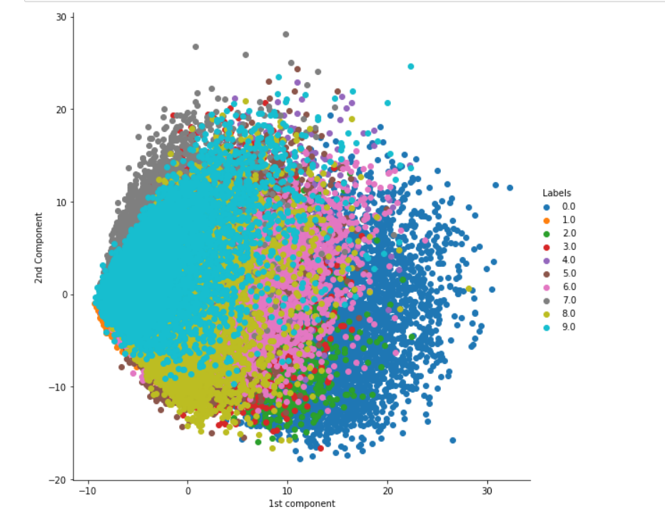
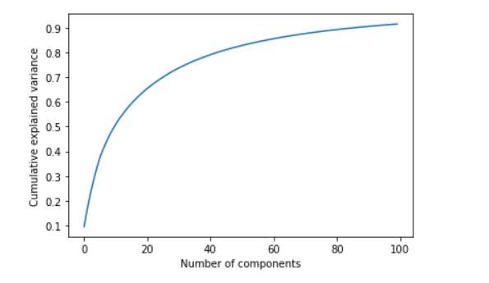
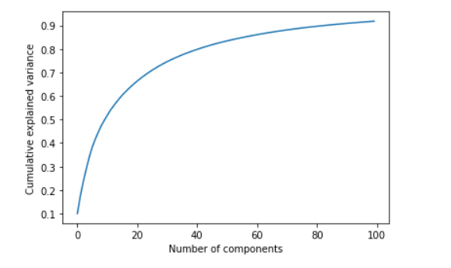
Principal Component Analysis
Train Dataset
Test Dataset
Steps of PCA – Covariance, Eigen vector
Optimal Components
First 2 components
Total Variance – 91%

Slide 6
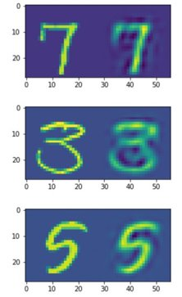
Images after decomposition
Information
Recognizable

Slide 7
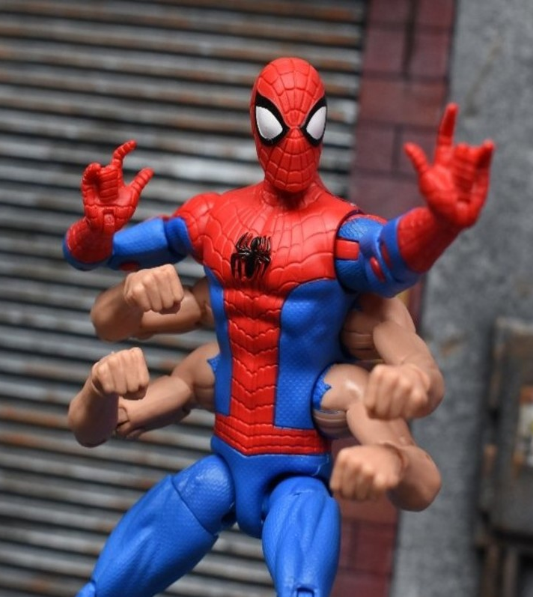
Parallelization
What is parallelization?
How it is beneficial?
Algorithm – Multi-threading
Create computing threads of a single process.
Runs parallel to each other
10x times faster (less than 0.0 sec) – Normal (0.4 sec)
Challenges

Slide 8
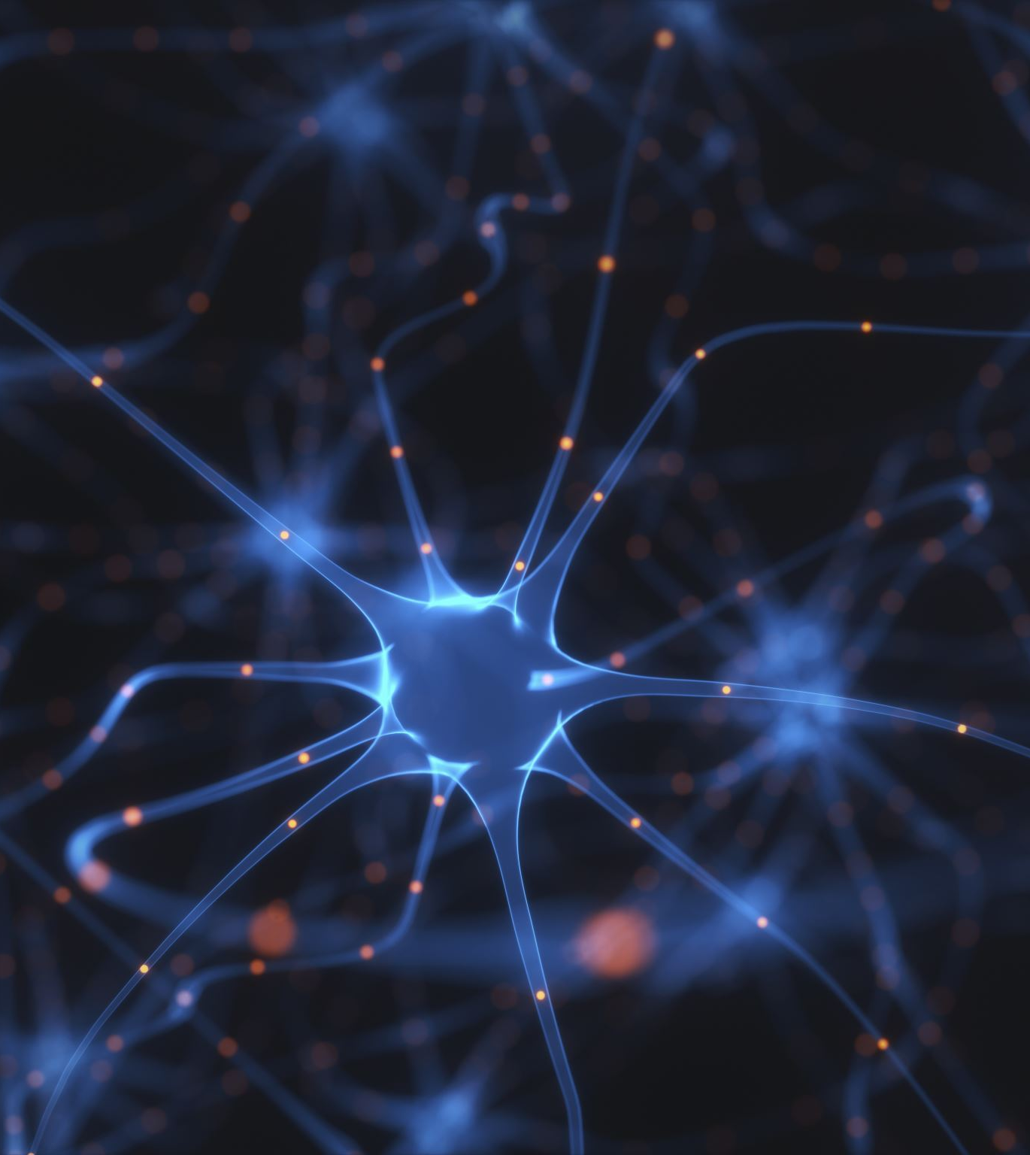
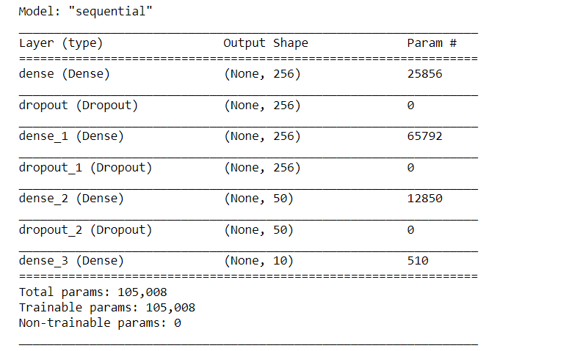
Modeling
Simple Neural Network
Model Architecture – Dense, Dropout, Param

Slide 9
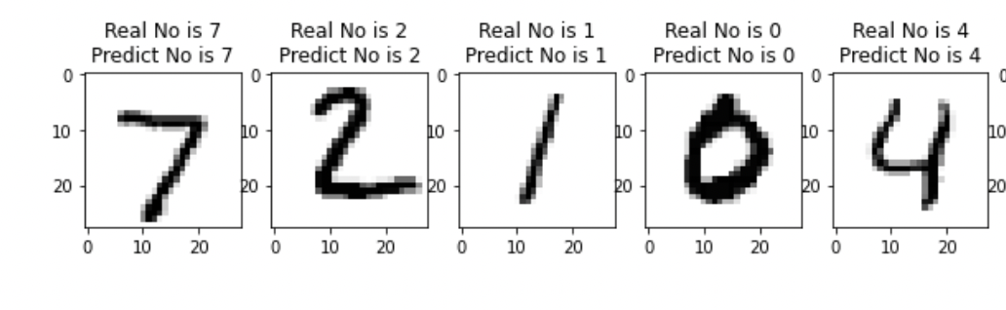
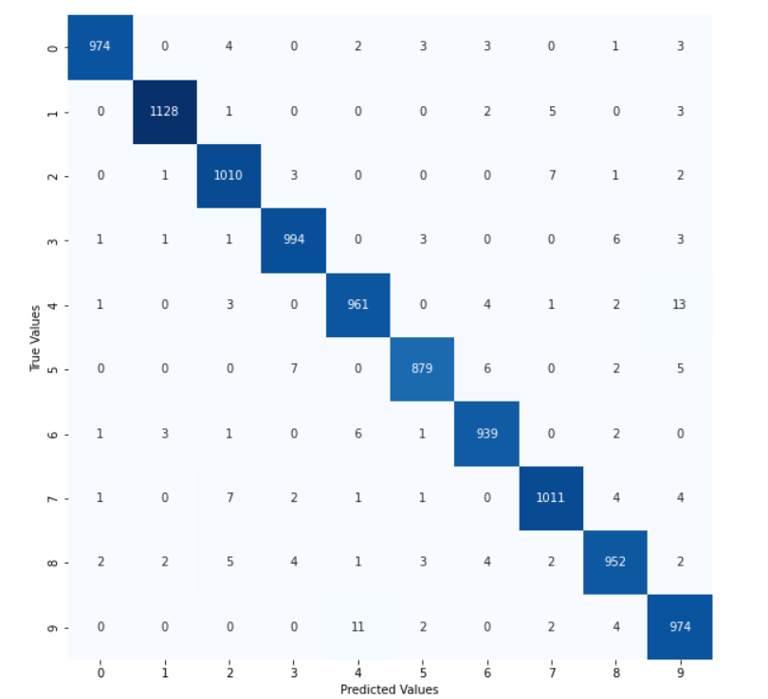
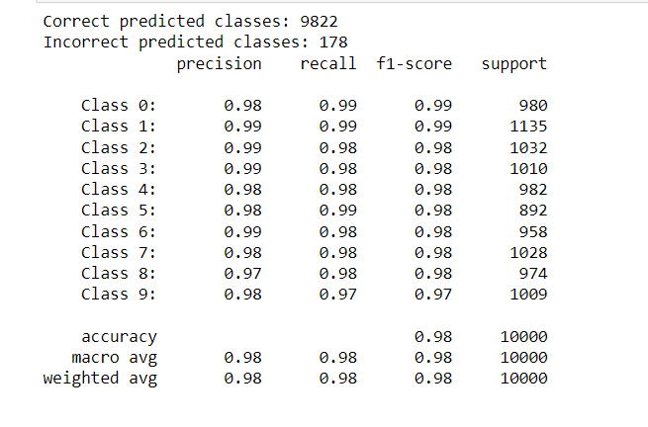
Results
Classification Report
Confusion Matrix

Slide 10
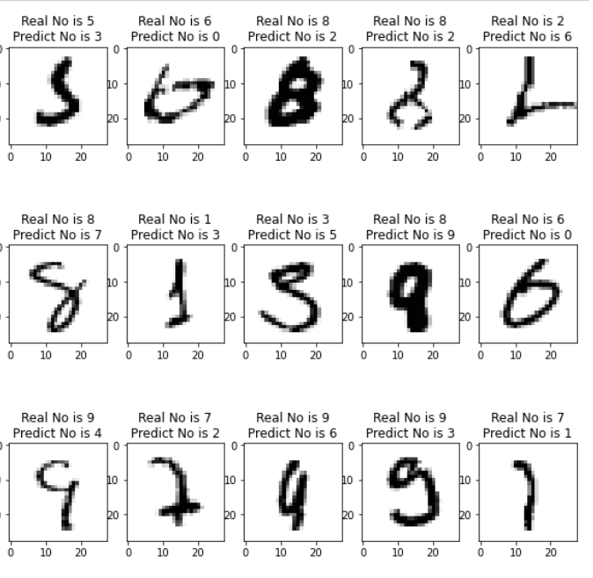
Misclassified

Slide 11

Applications
Big data / High-dimensional data
Image processing - Number plates of vehicles

Slide 12

Questions?

